Slide 1
Dimensionality Reduction

Slide 2
Overview
Curse of Dimensionality
Dimensionality Reduction
Singular Value Decomposition
Principle Component Analysis

Slide 3
Curse of Dimensionality
The number of input variables or features for a dataset is referred to as its dimensionality.
We can consider the columns of data representing dimensions on an n-dimensional feature space and the rows of data as points in that space
Having a large number of dimensions in the feature space can mean that the volume of that space is very large, and in turn, the points that we have in that space (rows of data) often represent a small and non-representative sample.

Slide 4
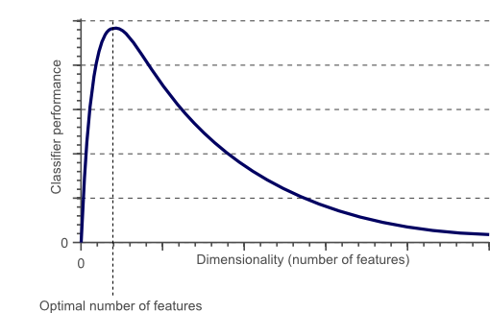
Curse of Dimensionality
It means that the error increases with the increase in the number of features. It refers to the fact that algorithms are harder to design in high dimensions and often have a running time exponential in the dimensions

Slide 5
Curse of Dimensionality
As the number of features increases, the model becomes more complex.
The more the number of features, the more the chances of overfitting.
A machine learning model that is trained on a large number of features, gets increasingly dependent on the data it was trained on and in turn overfitted, resulting in poor performance on real data, beating the purpose.
Avoiding overfitting is a major motivation for performing dimensionality reduction.

Slide 6
Dimensionality Reduction
The main idea: reduce the dimensionality of the space.
Project the d-dimensional points in a k-dimensional space so that:
  k << d
  distances are preserved as well as possible
Solve the problem in low dimensions

Slide 7
Why Dimensionality Reduction
Decreasing d also decreases the complexity of the inference algorithm during testing.
When an input is decided to be unnecessary, we save the cost of extracting it
When data can be explained with fewer features, we get a better idea about the data and knowledge extraction
When data can be represented in a few dimensions without loss of information, it can be plotted and analyzed visually for structure and outliers.

Slide 8
Dimensionality Reduction
Avoiding overfitting is a major motivation for performing dimensionality reduction.
Feature Selection: identifying relevant features by correlation/ covariance analysis
Feature Engineering: generating new features from existing features, by applying some transformations

Slide 9
Linear Dimensionality Reduction Methods
Principle Component Analysis (PCA)
Singular Value Decomposition (SVD)
Linear Discriminant Analysis (LDA)

Slide 10
PCA
Intuition: find the axis that shows the greatest variation, and project all points into this axis
f2
e1
e2
f1

Slide 11
PCA
It is a linear transformation that chooses a new
coordinate system for the data set such that
greatest variance by any projection of the data
set comes to lie on the first axis (then called the
first principal component), the second greatest variance on the second axis, and so on.
PCA can be used for reducing dimensionality by
eliminating the later principal components.

Slide 12
Recap
Variance and Covariance are a measure of the “spread” of a set of points around their center of mass (mean)
• Variance – measure of the deviation from the mean for points in one dimension e.g. heights
• Covariance as a measure of how much each of the dimensions vary from the mean with respect to each other.

Slide 13
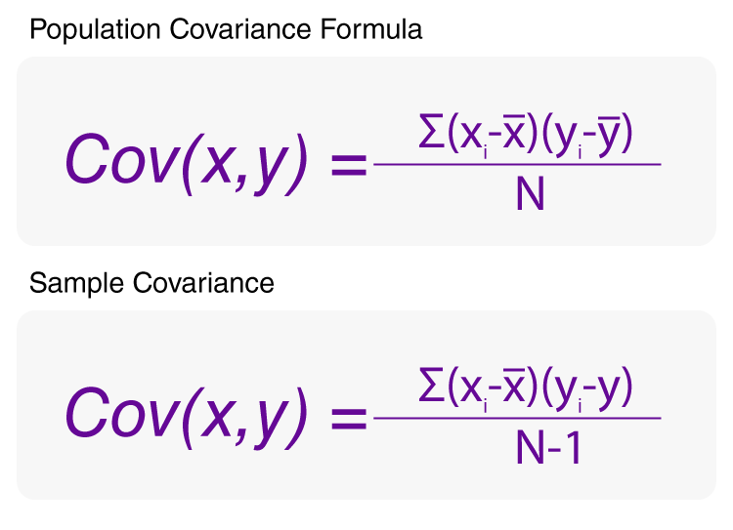
Covariance

Slide 14
PCA
The new variables/dimensions are linear combinations of the original ones
  Uncorrelated with one another
    Orthogonal in original dimension space
  Capture as much of the original variance in the data as possible
  Called Principal Components

Slide 15
Principal Components
First principal component is the direction of greatest variability (covariance) in the data
Second is the next orthogonal (uncorrelated) direction of greatest variability
  So first remove all the variability along the first component, and then find the next direction of greatest variability
And so on …

Slide 16
PCA
By finding the eigenvalues and eigenvectors of the covariance matrix, we find that the eigenvectors with the largest eigenvalues correspond to the dimensions that have the strongest correlation in the dataset.
• This is the principal component.

Slide 17

PCA: steps
1. Standardize the dataset
2. Compute Covariance matrix
3. Compute eigenvectors and eigen
Values of covariance matrix

Slide 18
PCA: steps
4. Find the feature vectors
Arrange the eigenvectors in the decreasing order of their eigen values
The feature vector is simply a matrix that has as columns the eigenvectors of the components that we decide to keep.
we choose to keep only p eigenvectors (components) out of n, the final data set will have only p dimensions.

Slide 19
PCA Step
5. Project the Data Along the Principal Components Axes

Slide 20
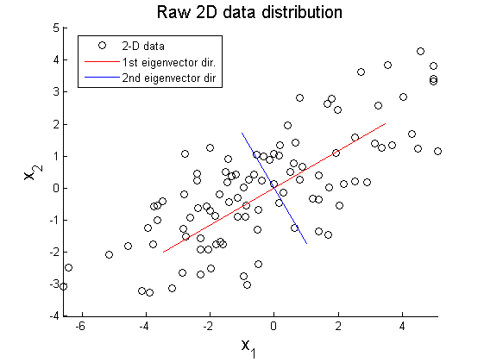
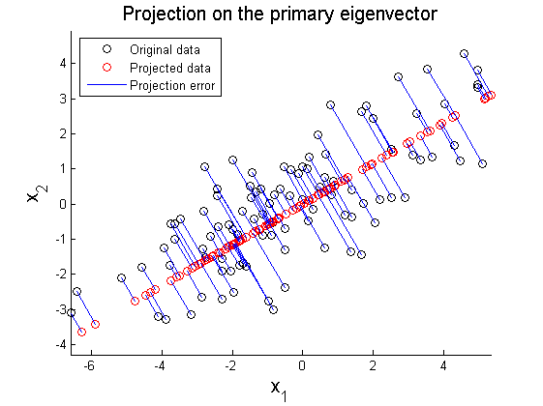
Example

Slide 21

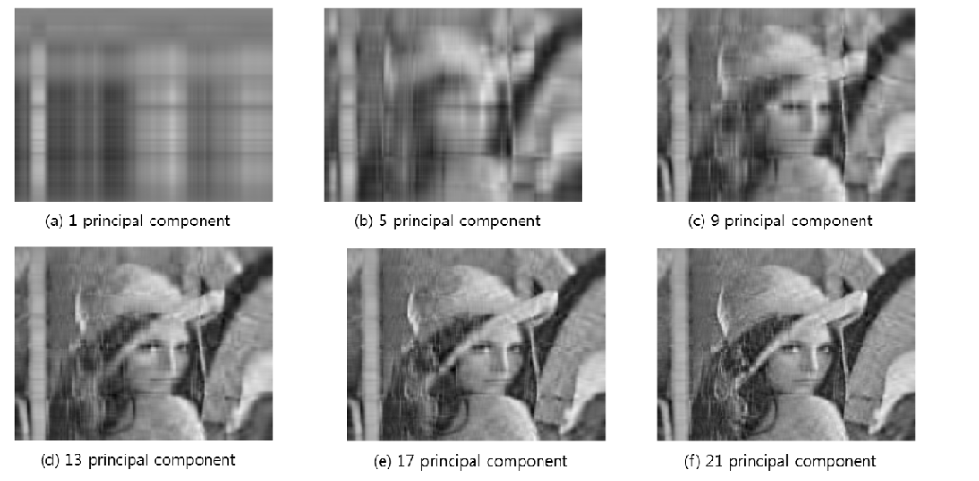
Example

Slide 22
SVD: The mathematical formulation
Normalize the dataset by moving the origin to the center of the dataset
Find the eigenvectors of the data (or covariance) matrix
These define the new space
Sort the eigenvalues in “goodness” order
f2
e1
e2
f1

Slide 23
SVD Cont’d
Advantages:
  Optimal dimensionality reduction (for linear projections)
Disadvantages:
  Computationally hard. … but can be improved with random sampling
  Sensitive to outliers and non-linearities

